Slide 1
General english
introduction

Slide 2
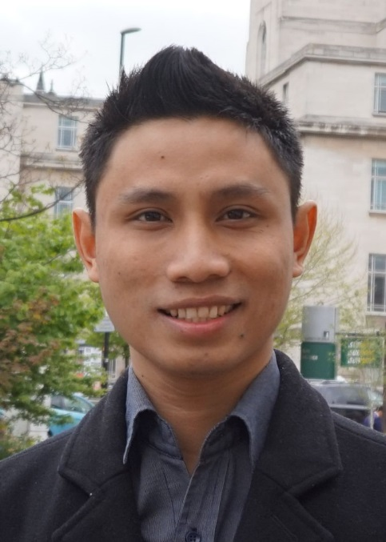
Hello
Sandra Sembel
(Coordinator)
sandra.sembel@uph.edu
Dwi Y. Nugroho
(Team member)
dwi.nugroho@uph.edu
Michael. R. Sihombing
(Team member)
michael.recard@uph.edu

Slide 3
GENERAL ENGLISH
Course Descriptions
What?
Roles
Learning Activities
Video Conference
Diagnostic Test
Class Policy
Participations
Assignments
Topics
Daily Assignments (KAT 1)
Discussion Forum
(KAT 2)
Presentations (KAT 3)
Cheating and Plagiarism
Objectives
Evaluation

Slide 4
1. Course descriptions

Slide 5
1.1. What?
This course prepares students to improve their mastery of ENGLISH language COMMUNICATION skills in ACADEMIC CONTEXT.

Slide 6
1.2.1. General learning objectives
Students are able to understand and use intermediate level of English in academic context
Comprehend various passages in English better and faster.
Present a topic meaningfully and convincingly.

Slide 7
1.2.2 Specific learning objectives
Analyze and create main ideas
Identify and classify relevant and irrelevant details
Guess meanings of unfamiliar words
Apply critical reading skills: Make inferences, summarize, paraphrase, synthesize
Produce outline and script of a one-minute speech
Present a one-minute speech

Slide 8
1.3. Roles
Students
Access and learn materials
Participate in online video conferences, discussion forums
Do assignments
Plan, prepare and present one-minute speech
Lecturers
Present materials
Guide and facilitate learning and discussions

Slide 9
1.4. Topics
Week | Topics | Activities | Remarks
1 | Course Introduction | Video Conference
2 | Diagnostic Test | On-line multiple choice test | 50 items
3 | Main Ideas | Independent learning (ppts) KAT 1.1. Identifying main ideas KAT 2.1. Discussion Forum 1
4 | Supporting Details | Independent learning (ppts) KAT 1.2.
5 | Vocabulary Strategies
6 | Pronoun Reference
7 | Simulation Test
8 | MID-TEST

Slide 10
1.4. topics
Course Intro
Diagnostic test
Main ideas
Supporting details
Vocabulary strategies
Pronoun reference
Informative speech preparation (outline, script)
Informative Speech (Speaking task) and Simulation Test 1
MID-Test
Video conference 2: Inferencing
Paraphrasing
Summarizing
Synthesizing
Persuasive speech preparation (outline and script)
Persuasive speech presentation (speaking task)
Simulation Test 2
FINAL TEST

Slide 11
1.5. evaluation
KAT 1 (10%)
KAT 2 (10%)
KAT 3 (15%)
Mid-Exam (25%)
Final Exam (40%)
Weekly Tasks (10 tasks)
Participation in discussion forum (6 sessions)
Two One-minute Speeches (Outline, script and presentations)
Online test (multiple choice)
Independent speaking and writing test
Online test (multiple choice)
Integrated speaking and Writing test

Slide 12
Summary 1
1. Course Descriptions
What?
1.1. ENGLISH language COMMUNICATION skills in ACADEMIC CONTEXT.
Objectives
1.2. understand and use intermediate level of English in academic context
Roles
1.3. Lecturer: Facilitator; Students: Active participants
1.4. Main topics: Main ideas, supporting details, vocabulary strategies, inference, paraphrasing, summarizing, synthesizing
Topics
Evaluation
1.5. KAT 1 (10%), KAT 2 (10%), KAT 3 (15%), Mid Test (25%), Final Test (40%)

Slide 13
Setting a goal
You are never too old to set another goal or to dream a new dream. – C.S.Lewis

Slide 14
What does it mean?
Many people say it’s easier to set a goal to learn a language when you are young.
BUT Language is God’s Special Gift to Humans.
So, don’t worry about age, we all can learn a new language even when we are not very young anymore – When there is a will there is a way!

